Slide 1
Messaging patterns

Slide 2
Pipes and Filters

Slide 3
What is Pipes and Filters
Decompose a task that performs complex processing into a series of separate elements that can be reused.
This can improve performance, scalability, and reusability by allowing task elements that perform the processing to be deployed and scaled independently.

Slide 4
Context and problem
An application is required to perform a variety of tasks of varying complexity on the information that it processes.
A straightforward but inflexible approach to implementing an application is to perform this processing as a monolithic module. However, this approach is likely to reduce the opportunities for refactoring the code, optimizing it, or reusing it if parts of the same processing are required elsewhere within the application.

Slide 5
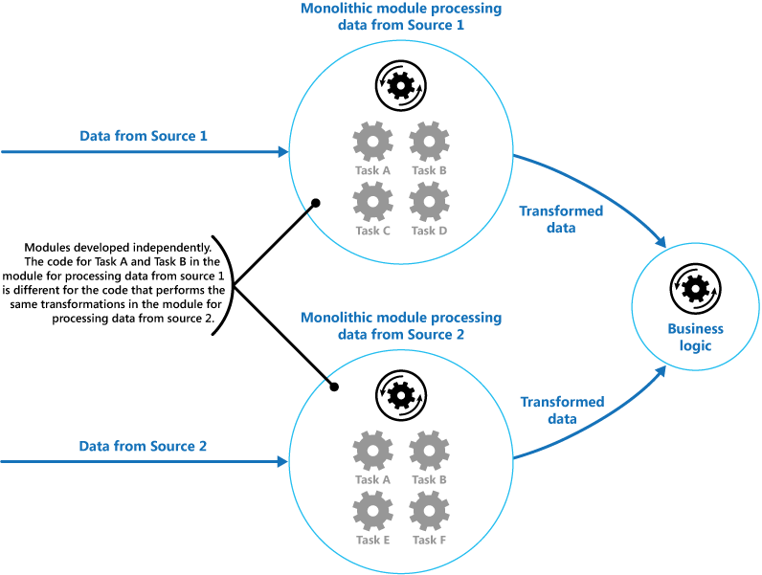
The figure illustrates the issues with processing data using the monolithic approach. An application receives and processes data from two sources. The data from each source is processed by a separate module that performs a series of tasks to transform this data, before passing the result to the business logic of the application.

Slide 6
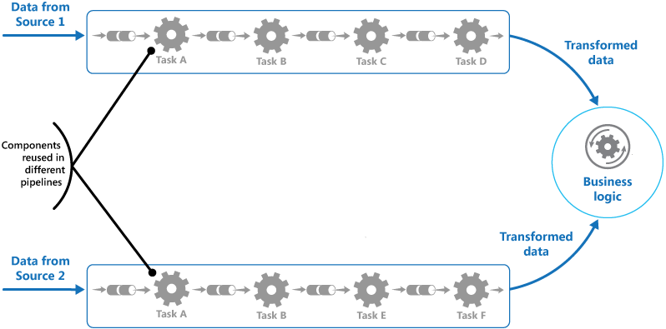
Solution
Break down the processing required for each stream into a set of separate components (or filters), each performing a single task. By standardizing the format of the data that each component receives and sends, these filters can be combined together into a pipeline. This helps to avoid duplicating code, and makes it easy to remove, replace, or integrate additional components if the processing requirements change. The next figure shows a solution implemented using pipes and filters.

Slide 7
Issues and considerations
Complexity. The increased flexibility that this pattern provides can also introduce complexity, especially if the filters in a pipeline are distributed across different servers.
Reliability. Use an infrastructure that ensures that data flowing between filters in a pipeline won't be lost.

Slide 8
When to use this pattern
The processing required by an application can easily be broken down into a set of independent steps.
The processing steps performed by an application have different scalability requirements.
It's possible to group filters that should scale together in the same process. For more information, see the Compute Resource Consolidation pattern.

Slide 9
Priority Queue

Slide 10
What is Priority Queue pattern
Prioritize requests sent to services so that requests with a higher priority are received and processed more quickly than those with a lower priority. This pattern is useful in applications that offer different service level guarantees to individual clients.

Slide 11
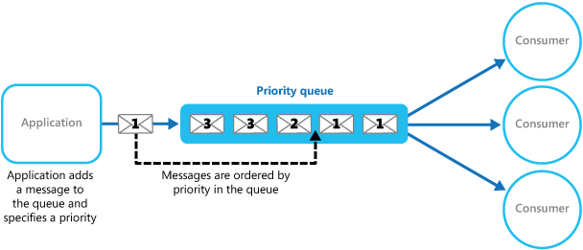
Solution
A queue is usually a first-in, first-out (FIFO) structure, and consumers typically receive messages in the same order that they were posted to the queue. However, some message queues support priority messaging. The application posting a message can assign a priority and the messages in the queue are automatically reordered so that those with a higher priority will be received before those with a lower priority. The figure illustrates a queue with priority messaging.

Slide 12
Advantages
It allows applications to meet business requirements that require prioritization of availability or performance, such as offering different levels of service to specific groups of customers.
The multiple message queue approach can help maximize application performance and scalability by partitioning messages based on processing requirements.
It can help to minimize operational costs. In the single queue approach, you can scale back the number of consumers if necessary. High priority messages will still be processed first (although possibly more slowly), and lower priority messages might be delayed for longer.

Slide 13
When to use this pattern
This pattern is useful in scenarios where:
The system must handle multiple tasks that have different priorities.
Different users or tenants should be served with different priority.

Slide 14
example
public static class PriorityQueueConsumerHighFn{ [FunctionName("HighPriorityQueueConsumerFunction")]
public static void Run( [ServiceBusTrigger("messages", "highPriority", Connection = "ServiceBusConnection")]string highPriorityMessage, ILogger log)
{
log.LogInformation($"C# ServiceBus topic trigger function processed message: {highPriorityMessage}");
}
}

Slide 15
Publisher-Subscriber

Slide 16
What is Publisher-Subscriber
Enable an application to announce events to multiple interested consumers asynchronously, without coupling the senders to the receivers.
Also called: Pub/sub messaging

Slide 17
Context and problem
n cloud-based and distributed applications, components of the system often need to provide information to other components as events happen.
Asynchronous messaging is an effective way to decouple senders from consumers, and avoid blocking the sender to wait for a response. However, using a dedicated message queue for each consumer does not effectively scale to many consumers.

Slide 18
Solution
Introduce an asynchronous messaging subsystem that includes the following:
An input messaging channel used by the sender.
One output messaging channel per consumer
A mechanism for copying each message from the input channel to the output channels for all subscribers interested in that message

Slide 19
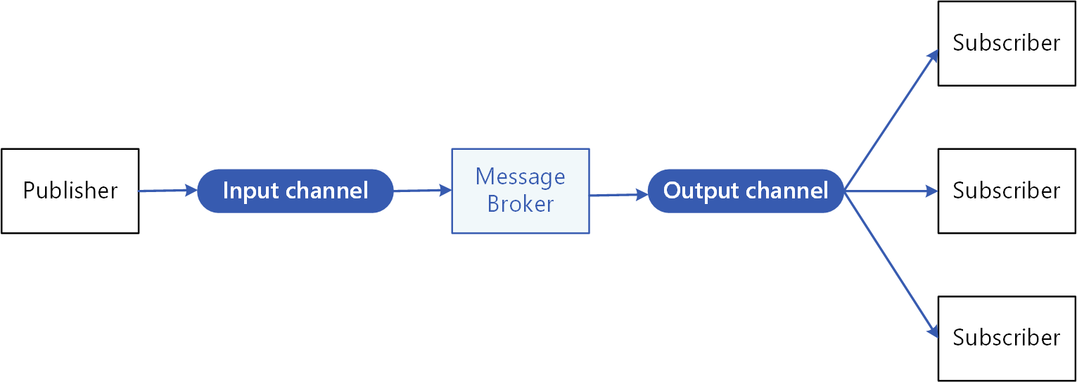
The following diagram shows the logical components of this pattern:

Slide 20
When to use this pattern
An application needs to broadcast information to a significant number of consumers.
An application needs to communicate with one or more independently-developed applications or services, which may use different platforms, programming languages, and communication protocols.
An application can send information to consumers without requiring real-time responses from the consumers.

Slide 21
Queue-Based Load Levelling

Slide 22
What is Queue-Based Load Leveling pattern
Use a queue that acts as a buffer between a task and a service it invokes in order to smooth intermittent heavy loads that can cause the service to fail or the task to time out.
This can help to minimize the impact of peaks in demand on availability and responsiveness for both the task and the service.

Slide 23
Solution
Refactor the solution and introduce a queue between the task and the service. The task and the service run asynchronously. The task posts a message containing the data required by the service to a queue. The queue acts as a buffer, storing the message until it's retrieved by the service.
The service retrieves the messages from the queue and processes them. Requests from a number of tasks, which can be generated at a highly variable rate, can be passed to the service through the same message queue. This figure shows using a queue to level the load on a service.

Slide 24
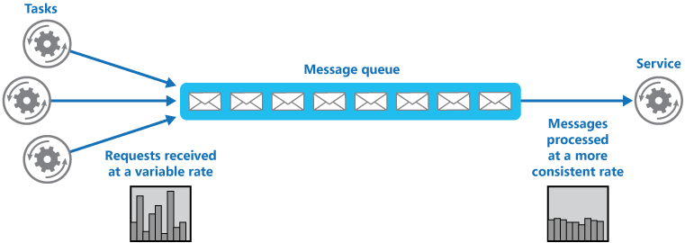
The queue decouples the tasks from the service, and the service can handle the messages at its own pace regardless of the volume of requests from concurrent tasks. Additionally, there's no delay to a task if the service isn't available at the time it posts a message to the queue.

Slide 25
When to use this pattern
This pattern is useful to any application that uses services that are subject to overloading.
This pattern isn't useful if the application expects a response from the service with minimal latency.

Slide 26
Thank you

